Slide 1


CS542 Project
Team 4
Jiexuan Sun, Congyang Wang,
Zhaoning Su, Yiming Zhao
Notes:
127.0.0.1

Slide 2
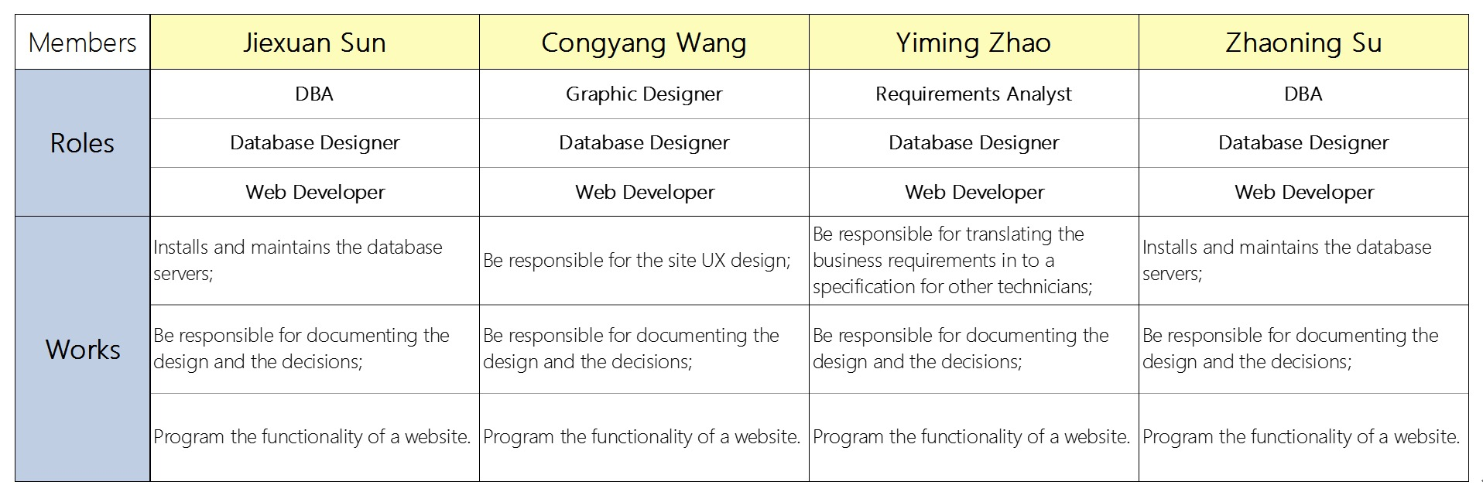
Team Introduction
Introducing Team 4

Slide 3
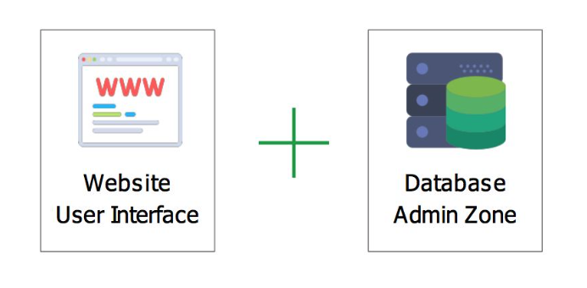
Project Introduction
Project Scope:
Tools:
Backbone is a website-based talent sharing platform serving for both internet start-ups and their technician workers .
Backbone’s aim is to solve problems of the start-ups’ ‘talent crisis’, high cost of talent management and help their employee’s reduce the unemployment risk.
Talent Crisis
Cost of talent management
Start-ups’ employee’s high Unemployment risk
( High Talent Mobility)
Approach:
Compositions:
Performance and Skill-Score Assessment Part.
(NDA & Third Party)
Communal Human Resources Part.
Career Gamification.
(Career Record, Interestingness, Personal Improvement)

Slide 4
Project Demonstration
Background:
Now:
ALLYSON just got his master degree of computer science from WPI. He is tired of working in big companies. The working environment is overwhelming in terms of the hierarchy within the firm. The lack of personal attention makes his personal opinions unheard. He wants to start his career in start-ups. But he knows that working in start-ups means uncertainty. So he hesitates for a long time until he knows BACKBONE!
WOLF TECH is a start-up. Due to the necessity for expansion of the company, it opens many positions for talents recently. However, seldom qualified people apply for the positions. On the one side, real talented people are not willing work in start-ups. On the other side, the lack of human resources department makes the company not competitive in labor market. The problem of talent shortage impedes the growth of the company until the coming of BACKBONE!
Demonstration
Time!

Slide 5
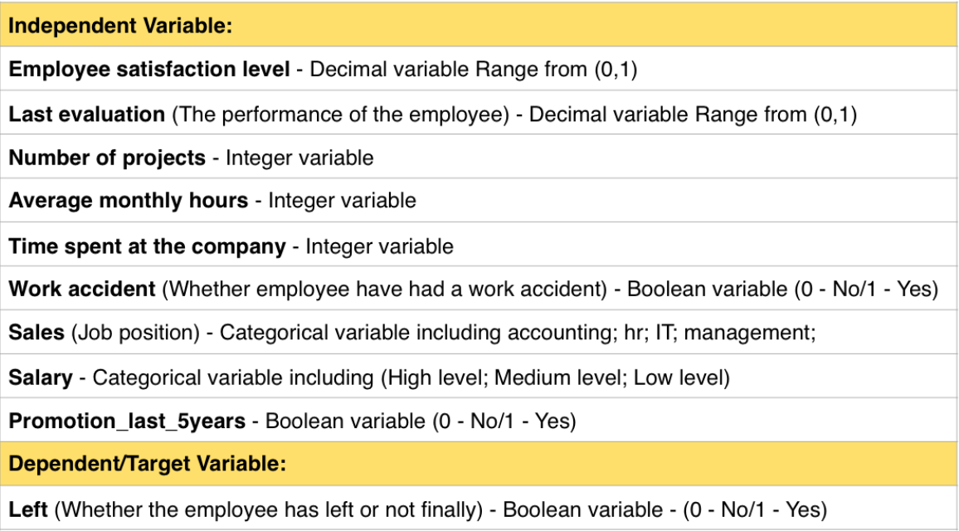
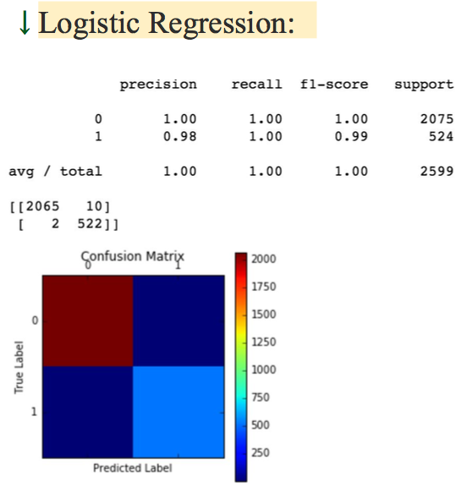
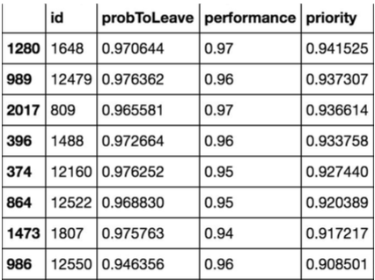
Project Summary
The Challenges:
Improvement:
Data creation
All the possible Scenarios
Talent Loss Detection Part
What We Learned:
Index Tuning/The importance of index
Self-directed study（Many Resources)
Collaboration

Slide 6
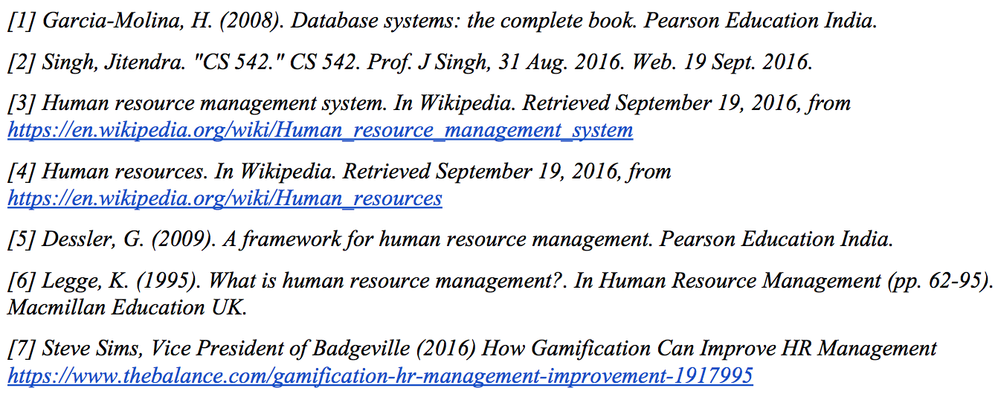
Project Resources and Reference
Resources and Reference:
Special Thanks:
Prof. J Singh
Sijing Liu
Chao Xu

Slide 7
Thank you!
&
Question Time!

